Slide 1
When to use domain driven design and when not
Speaker : Nikola Ajdukovic

Slide 2
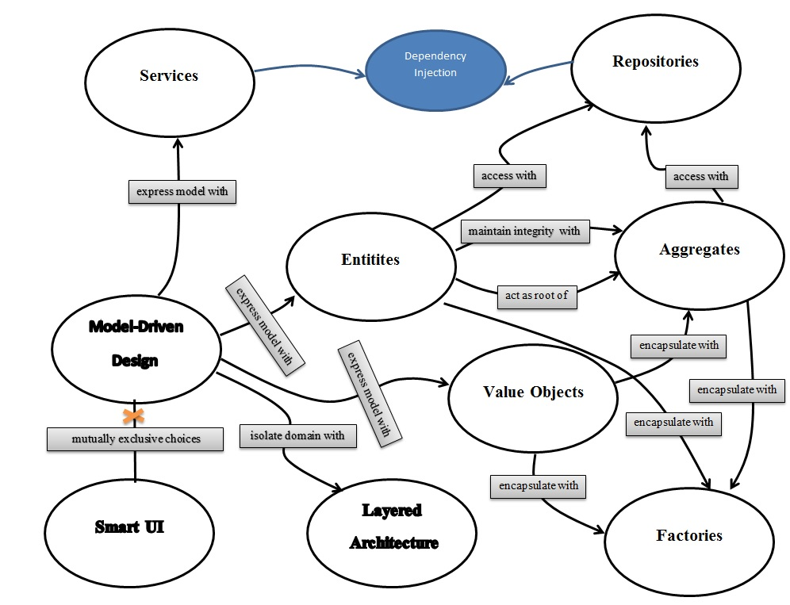

Slide 3
CQRS(Command Query Responsibility Segregation) PATTERN
The principle states that a well designed object should have methods that are either commands or queries

Slide 4
CQRS(Command Query Responsibility Segregation) PATTERN
A command changes the state of an object, but does not return any data
A query returns data and does not change any state

Slide 5
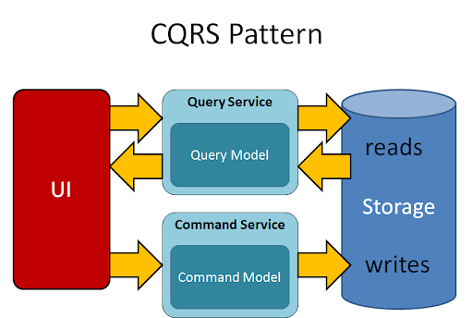

Slide 6
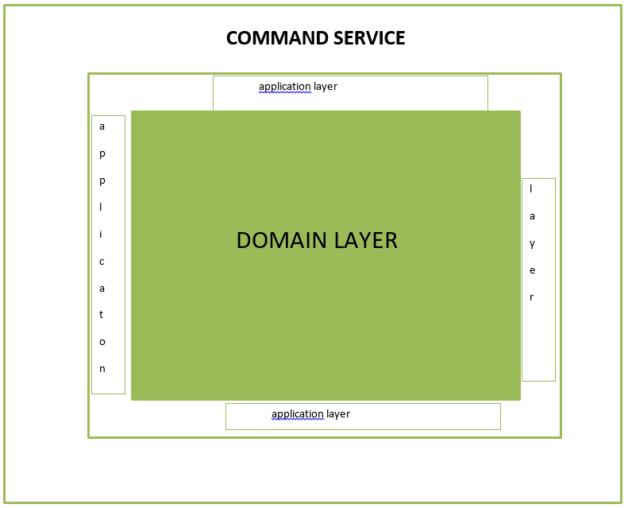

Slide 7
QUERY IN CQRS PATTERN
A query returns data and does not change any state
A query does not change any state => no business logic
=> no domain layer
=> no domain driven design

Slide 8
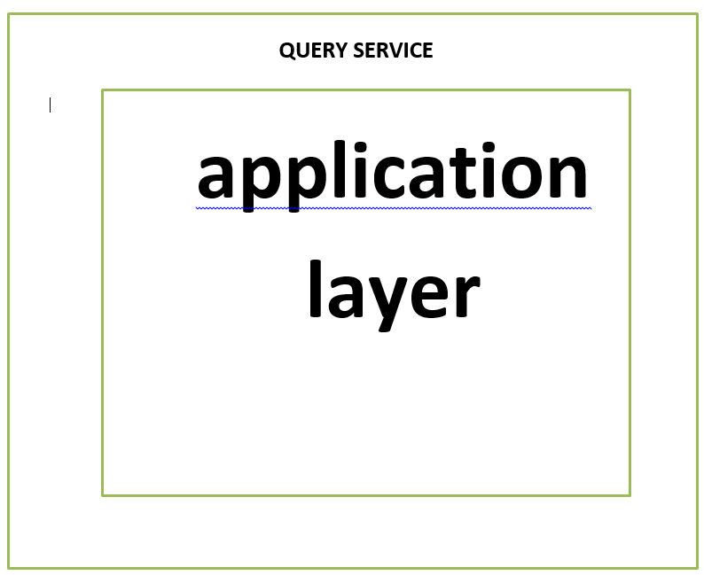

Slide 9
COMMANDS AND QUERIES
Commands with a lot of business logic => DDD YES
Commands with a little of business logic => DDD usually NO
Queries doesn’t have business logic => DDD NO

Slide 10
QUESTIONS ?
Thank you for your attention
The end

